Slide 1
Algoritmi sortare
Barbu Robert-Gabriel
Grupa 134

Slide 2
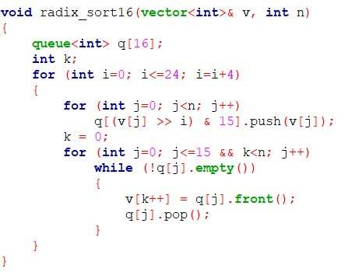
Radix Sort baza 2^4 complexitate: O(n*k), k= lungimea nr

Slide 3
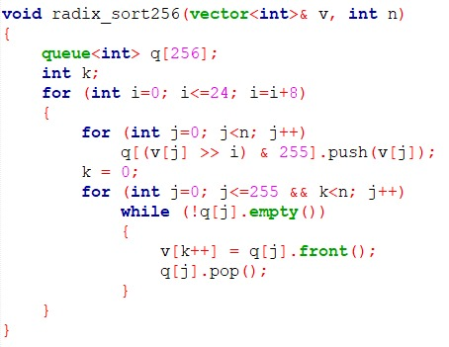
Radix Sort baza 2^8 complexitate: O(n*k), k= lungimea nr

Slide 4
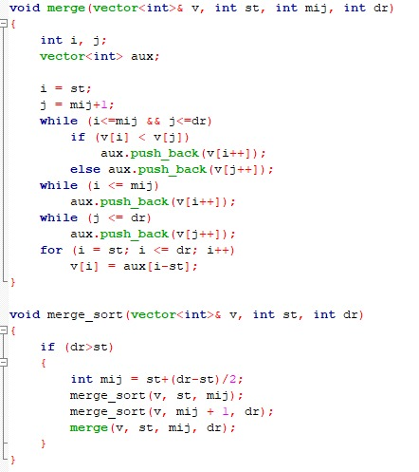
Merge Sort complexitate: O(n logn)

Slide 5
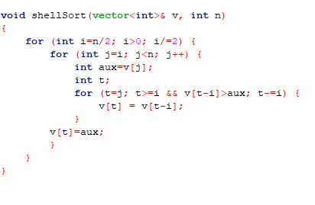
Shell sort complexitate: medie- O(nlogn), in cel mai rau caz- O(n²)

Slide 6
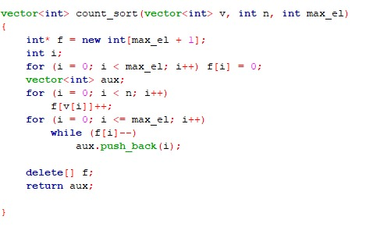
Counting Sort complexitate: O(n+MAX), unde MAX este cel mai mare numar din vector

Slide 7
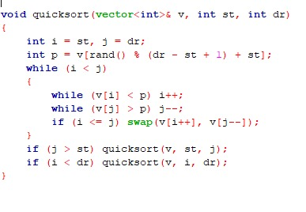
Quicksort complexitate: O(nlogn)

Slide 8

Sortare Nativa complexitatea O(nlogn)

Slide 9
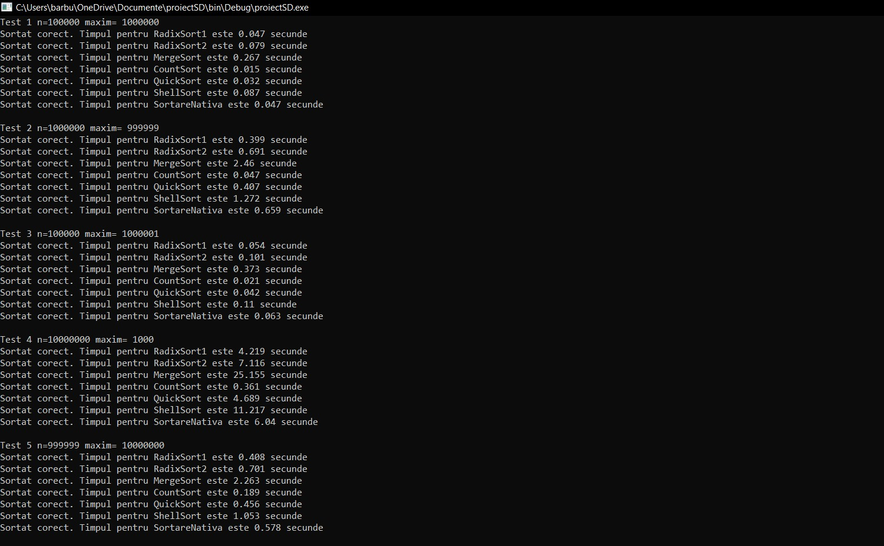
Rezultate obtinute pe mai multe teste

Slide 10
Comparare sortari pentru fiecare test in functie de rapiditate
Test 1- n=100000 maxim= 1000000
Merge Sort < Shell Sort < Radix Sort b2^4 < Sortare Nativa <= Radix Sort b2^8 < Quick Sort <Counting Sort
Test 2- n=1000000 maxim= 999999
Merge Sort< Shell Sort< Radix Sort b2^4< Sortare Nativa< Quick Sort< Radix Sort b2^8< Counting Sort
Test 3- n=100000 maxim= 1000001
Merge Sort< Shell Sort< Radix Sort b2^4< Sortare Nativa< Radix Sort b2^8< Quick Sort <Counting Sort
Test 4- n=10000000 maxim= 1000
Merge Sort< Shell Sort< Radix Sort b2^4< Sortare Nativa< Quick Sort < Radix Sort b2^8< Counting Sort
Test 5- n=999999 maxim= 10000000
Merge Sort< Shell Sort< Radix Sort b2^4< Sortare Nativa< Quick Sort < Radix Sort b2^8< Counting Sort

Slide 11
Concluzii
Se observa ca in programul meu Merge Sort-ul este cel mai lent, iar Counting Sort-ul cel mai rapid

